Slide 1
Expanding Energy Efficiency for BC Hydro:
Lessons from Industry Leaders
June 19, 2012
Prepared for the BC Sustainable Energy Association

Slide 2
Overview
Key Terms and Concepts
BC Hydro’s IRP
US Data on Energy Efficiency
GEEG’s Empirical Research and Analysis
Predicting Efficiency Costs for BC Hydro
Impact of Expanded Efficiency for BC Hydro
Program Enhancements

Slide 3
1. Key Terms and Concepts

Slide 4
Types of Savings
Usage before EE
Annual Energy Savings (kWh-yr)
Usage after EE
Annual Peak Demand
Savings (kW-yr)
kW
Year 1
Year 2
Year 3

Slide 5
Savings Depth (%)
Sales
÷
Annual Savings
Annual Sales
Savings
kWh-yr
Year 1
Year 2
Year 3

Slide 6
Why Use Sales as Basis for Depth?
Annual sales correlates more closely to the size of efficiency opportunities.
Growth rates more volatile.
Why not use sales growth rate as basis for savings depth?

Slide 7
Savings Tiers
Tier | Definition
Tier 1 | Savings Depth ≥ 1.5% Target = 2%
Tier 2 | 1.5% > Savings Depth ≥ 0.67% Target = 1%
Tier 3 | 0.67% > Savings Depth ≥ 0.33% Target = 0.5%
Tier 4 | 0.33% > Savings Depth Target = 0.25%

Slide 8
Unit Costs vs Levelized Costs
Divide cost by annual
savings to get
Initial Cost
$$$
Unit Costs ($/kWh-yr)
=
Levelized Costs ($/kWh)
…
kWh-yr
kWh-yr
kWh-yr
kWh-yr
Amortize the cost over
the period of savings to get
Year 1
Year 2
Year 3
Year N
Many years of savings

Slide 9
Example Levelized Cost Calculation
Given:
Unit Cost = $0.30/kWh-yr
Lifetime = 15 years
Real Discount Rate = 5.5%
Spread the initial cost over the life of the savings, similar to an annual payment on a $0.30 loan for 15 years at 5.5%
Levelized Cost =
= $0.0299/kWh
A cost now comparable to supply-side resources.
Slide was added after the presentation, for purposes of clarity.

Slide 10
Economies of Scale vs. Diminishing Returns
Economies of Scale
  Lower fixed costs as a percentage of total spending
Diminishing Returns
  More expensive measures for deeper savings
  Higher incentives required for everyone to get additional participants

Slide 11
Economies of Scale vs. Diminishing Returns (cont.)
As a portfolio ramps up,
economies of scale drive down costs
Cost of
Energy
Savings
Beyond a certain point,
the law of diminishing
returns pushes costs up
Savings as a Percentage of Sales

Slide 12
Cost-effectiveness Tests
TRC = Total Resource Cost Test
PAC = Program Administrator Cost Test (“Utility Cost Test”)
Benefit/Cost | Description | TRC | PAC
Benefit | Avoided Electric Costs | X | X
Benefit | Avoided Gas Costs | X | X
Benefit/Cost | Description | TRC | PAC
Benefit/Cost | Description | TRC | PAC
Cost | Administration Costs | X | X
Cost | Participant Costs | X
Cost | Customer Incentives |  | X

Slide 13
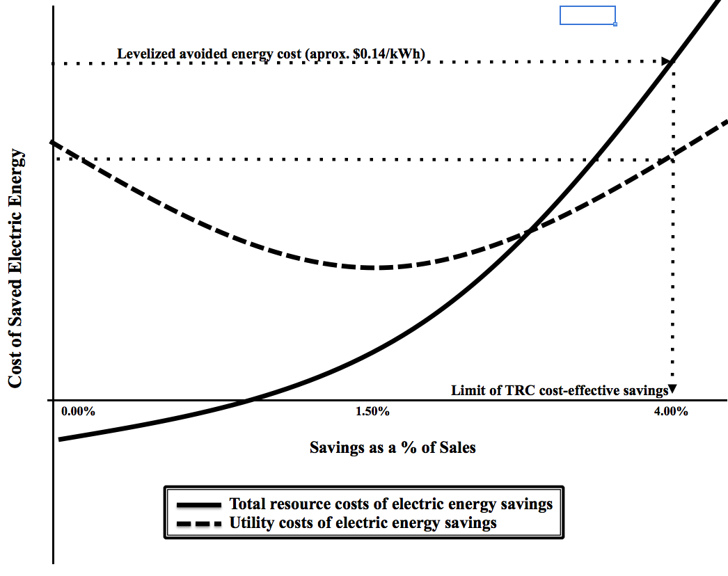
Cost of Energy Savings
TRC vs PAC

Slide 14
2. BC Hydro’s Latest IRP

Slide 15
BCHydro Projected Savings

Slide 16
BCHydro Savings % of Sales

Slide 17
BCHydro Projected Costs

Slide 18
3. US Data on Energy Efficiency

Slide 19
Electric Energy Savings in the US by Sector (from US EIA)

Slide 20
ACEEE Costs and Savings for States, 2006 and 2007
Tier 4
Tier 3
Tier 2
Tier 1
Grouping in Tiers 2 & 4
-yr
Unit Cost (2011$/kWh-yr)
General range of
$0.10 - $0.30
Source: American Council for an Energy Efficient Economy

Slide 21
4. GEEG’s Empirical Research and Analysis

Slide 22
Data Collected
Incremental annual energy savings and spending for residential and non-residential sectors where possible
Covering:
  23 States and 2 Canadian Provinces
  37 Program Administrators
  470 Program Years of Data
  $25 Billion of Spending (2011$)
  105,000 GWh/y of Cumulative Annual Savings

Slide 23
Collected Data by Savings Tier
Tier | Definition | Observations
Tier 1 | Savings ≥ 1.5% Target = 2% | Includes 9 program-years since 2005 from VT, CA, and CT.
Tier 2 | 1.5% > Savings ≥ 0.67% Target = 1% | 60 program-years fall in this tier, including IA, ME, MA, NV, NY, RI, HI, the Pacific Northwest, British Columbia, and Nova Scotia
Tier 3 | 0.67% > Savings ≥ 0.33% Target = 0.5% | States in this tier include AR, NJ, and WI
Tier 4 | 0.33% > Savings > 0 Target = 0.25% | States in this tier include OK and TX.

Slide 24
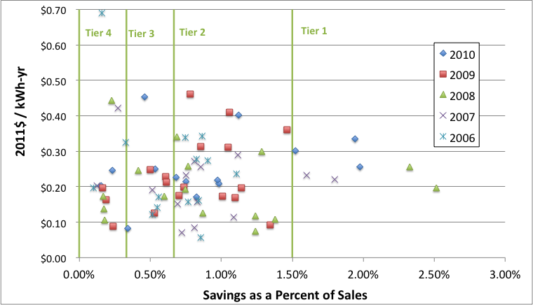
Historic Values
Most in Tier 2
Unit Cost (2011$/kWh-yr)
Convergence

Slide 25
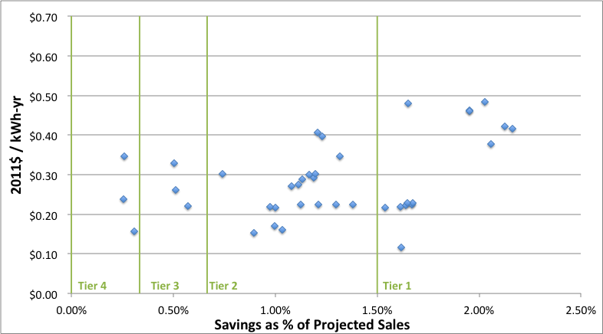
Planned Values
Unit Cost (2011$/kWh-yr)
Trend higher

Slide 26
Regression Model
Conducted multiple regression on dataset testing correlation between resource acquisition costs and:
  Savings Depth (% Savings)
  Time
  Customer Sector
  Location
Results:
  Adjusted R² = 0.875 (model accounts for all but 13.5% of sample variance in costs)
  Highly statistically significant variables (≥ 99.9% confidence-level)

Slide 27
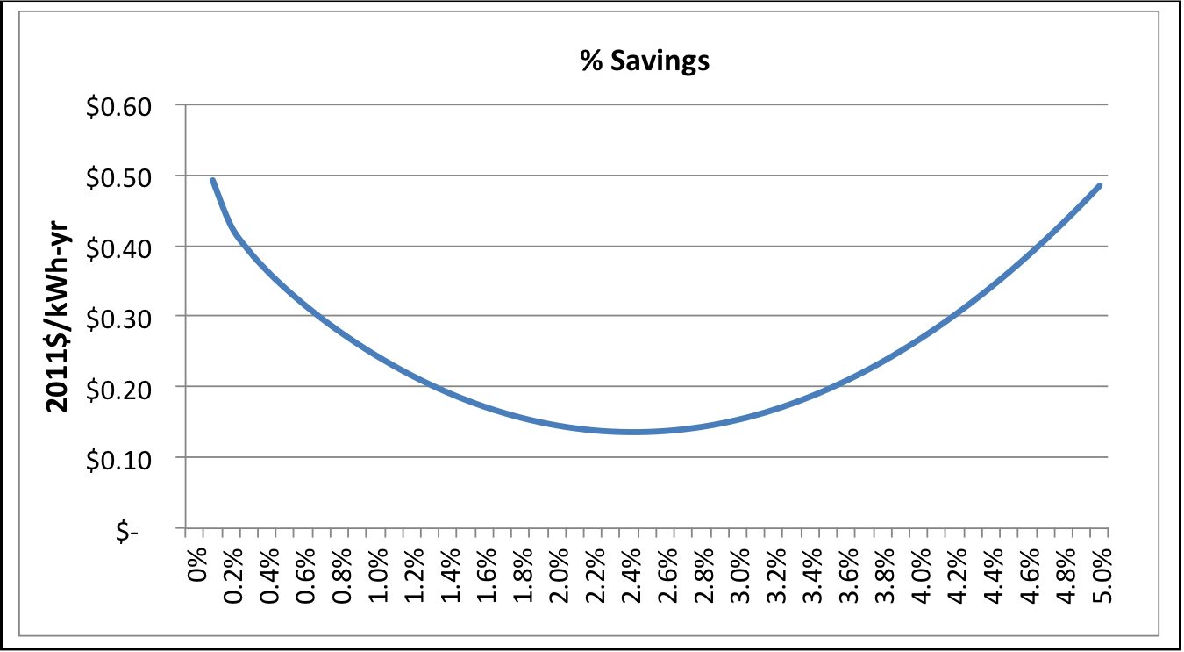
Effects of Savings Depth on Resource Acquisition Costs

Slide 28
Diminishing Returns over Time
Each additional year of maturity adds $0.075/kWh-y to the costs
Planned savings add $0.072/kWh-y to costs
Some locations have higher acquisition costs. Being in
  California adds $0.17/kWh-y
  New England adds $0.20/kWh-y

Slide 29
5. Predicting Efficiency Costs for BC Hydro

Slide 30
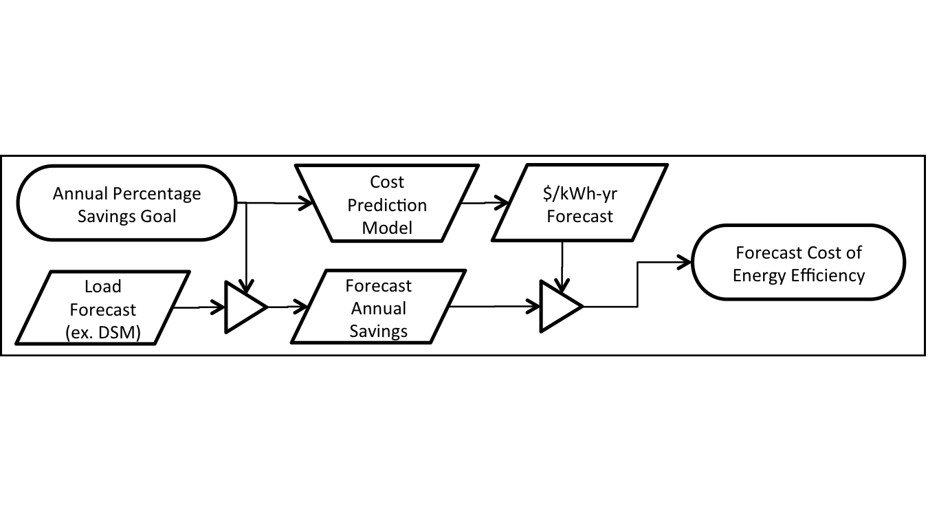
Overview of Approach

Slide 31
General Assumptions
Ramp up to 2.0% by 2014
Load forecast from IRP
Savings as a % of Sales
Savings Goals

Slide 32
Efficiency Resource Acquisition Costs

Slide 33
6. Impact of Expanded Efficiency for BC Hydro

Slide 34
Tier 1 Savings Scenario
Year | Incremental GWh Savings | Incremental MW Savings | Budgets (Millions 2011$)
Incremental Annual
2013 | 766 | 143 | $ 217.56
2014 | 1,063 | 198 | $ 268.62
2015 | 1,106 | 205 | $ 287.88
2016 | 1,145 | 213 | $ 306.99
2017 | 1,198 | 220 | $ 330.20
2018 | 1,279 | 235 | $ 361.51
2019 | 1,336 | 245 | $ 387.97
2020 | 1,361 | 250 | $ 406.64
2021 | 1,382 | 254 | $ 424.40
2022 | 1,398 | 256 | $ 441.02

Slide 35
Tier 1 Savings Scenario
Year | Cumulative GWh Savings | Cumulative MW Savings | Cumulative Budgets (Millions 2011$)
Cumulative Annual
2013 | 1,455 | 271 | $ 352.17
2014 | 2,469 | 460 | $ 620.79
2015 | 3,466 | 642 | $ 908.67
2016 | 4,463 | 829 | $ 1,215.67
2017 | 5,481 | 1,005 | $ 1,545.87
2018 | 6,514 | 1,195 | $ 1,907.37
2019 | 7,465 | 1,369 | $ 2,295.34
2020 | 8,371 | 1,535 | $ 2,701.98
2021 | 9,228 | 1,693 | $ 3,126.38
2022 | 10,017 | 1,837 | $ 3,567.40

Slide 36
Cumulative Budgets

Slide 37
Energy Requirements vs. Supply Resources

Slide 38
Peak Requirements vs. Supply Resources

Slide 39
Cumulative Energy Savings

Slide 40
Levelized Costs
Sector | Levelized Cost 2012$/MWh
 | Min (F2014) | Max (F2032)
Residential | $40.8 | $60.8
Non-Residential | $23.0 | $38.0
Total | $29.3 | $45.9

Slide 41
7. Program Enhancements

Slide 42
Scale up Savings
Increase pace and scale
Target customer sectors
Maximize net benefits

Slide 43
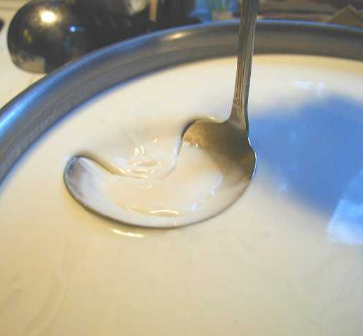
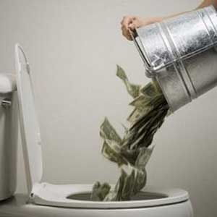

Avoid
1. Cream-skimming
=
2. Lost-opportunities

Slide 44




Encourage
Integration of program design and delivery
Across fuels and service areas.

Slide 45
Go Deeper
Enhance programs to get as much a savings per project
as economically possible
Important sectors include:
Low-income
Residential
Small-to-medium Commercial

Slide 46
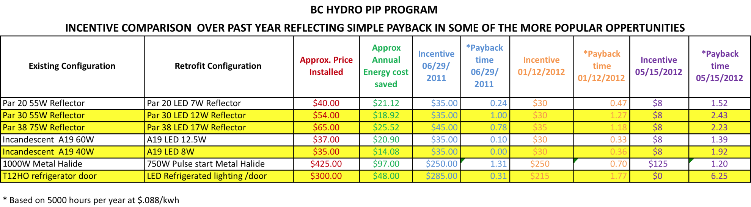
Redesign Incentives

Slide 47
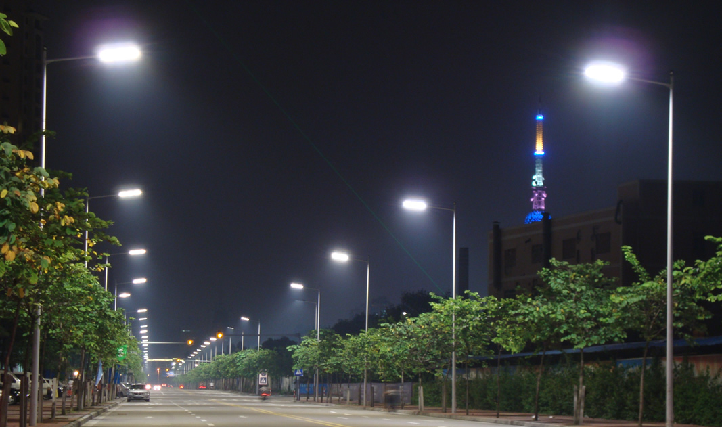
Convert Street Lighting
LED Street Lights in Foshan, China

Slide 48
Lead by Example
Long-term capital plan to capture all cost-effectively achievable efficiency

Slide 49

Questions?
John Plunkett
plunkett@greenenergyeconomics.com
www.greenenergyeconomics.com

